Slide 1

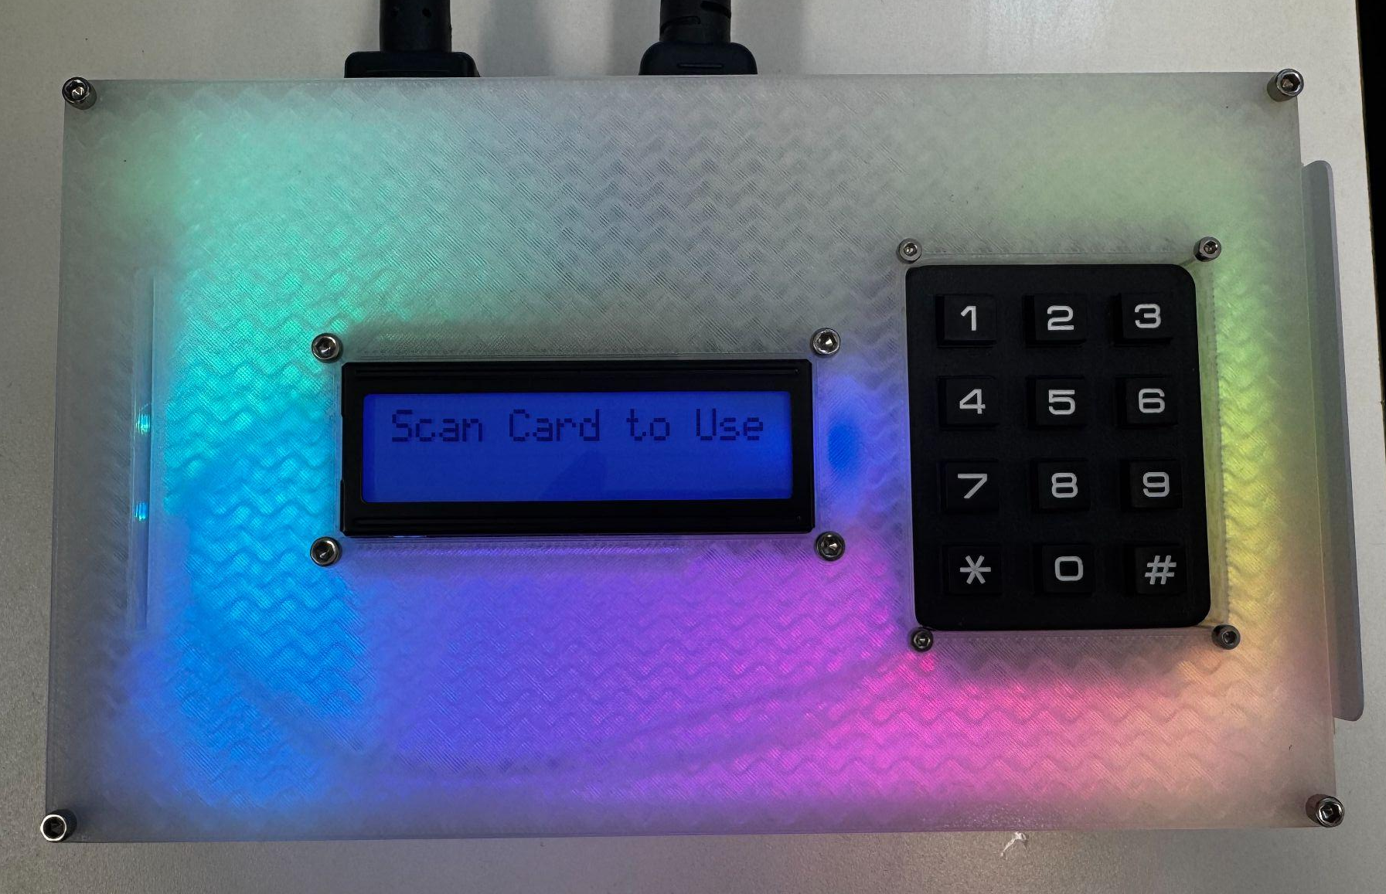
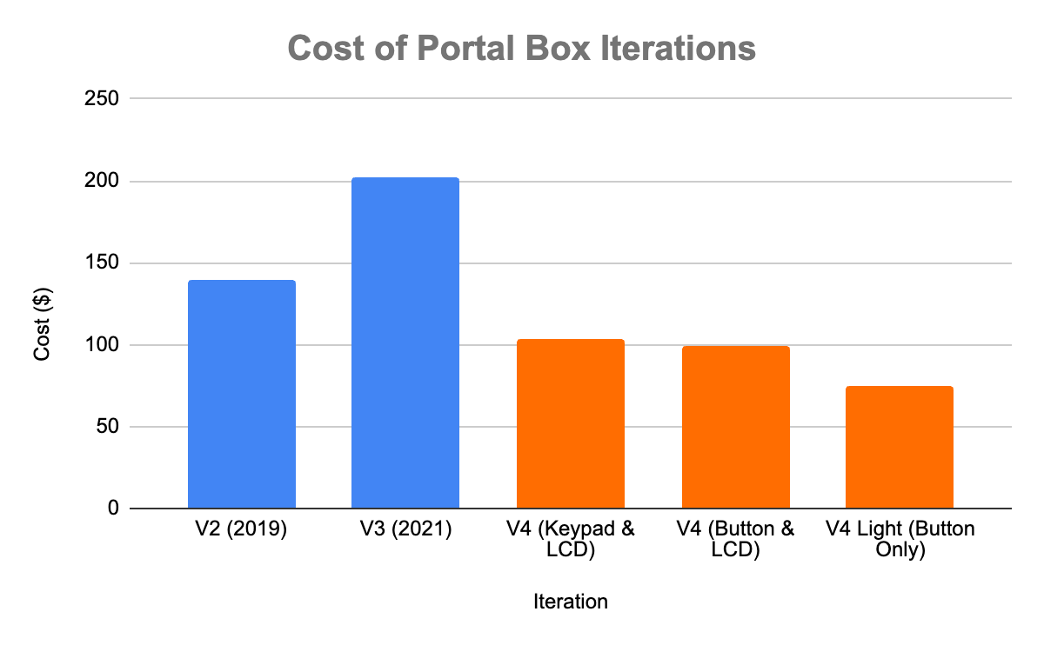
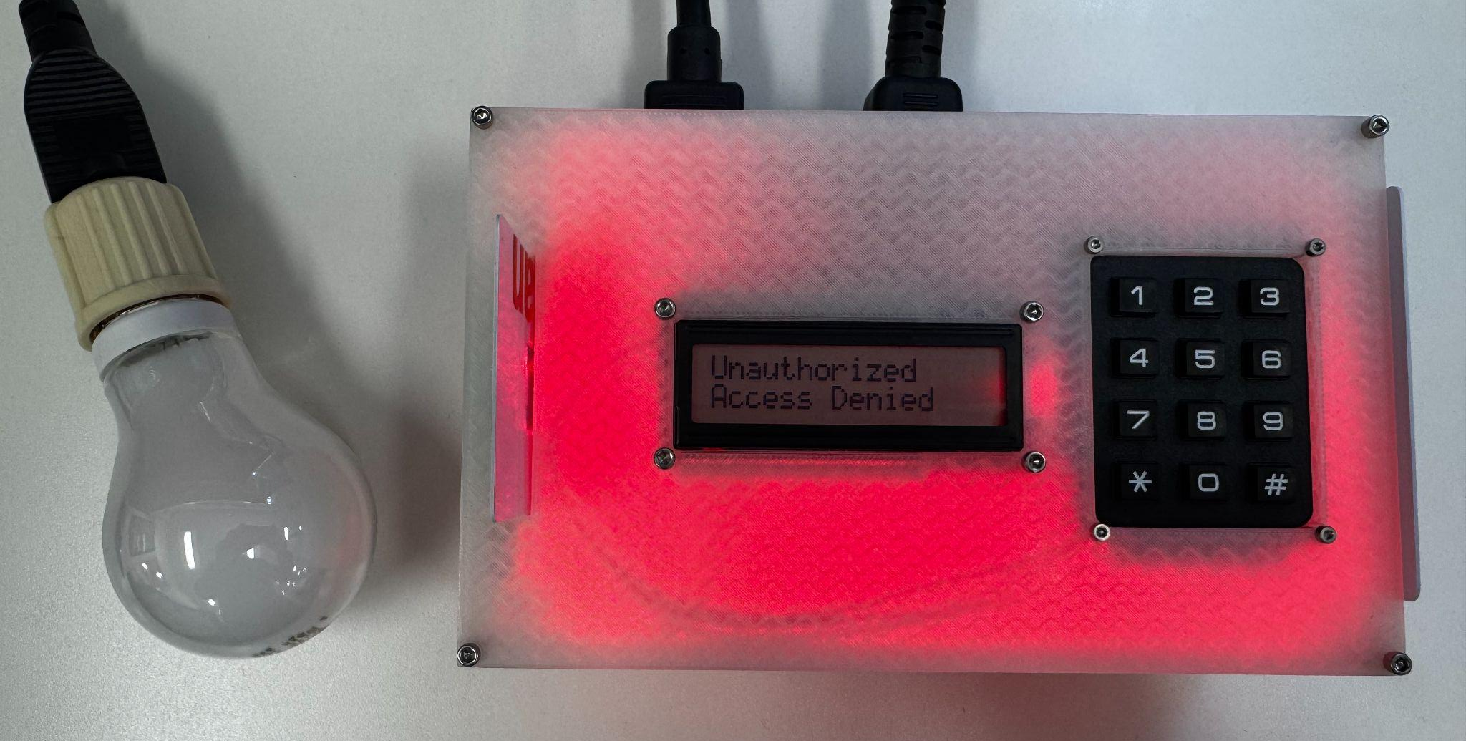
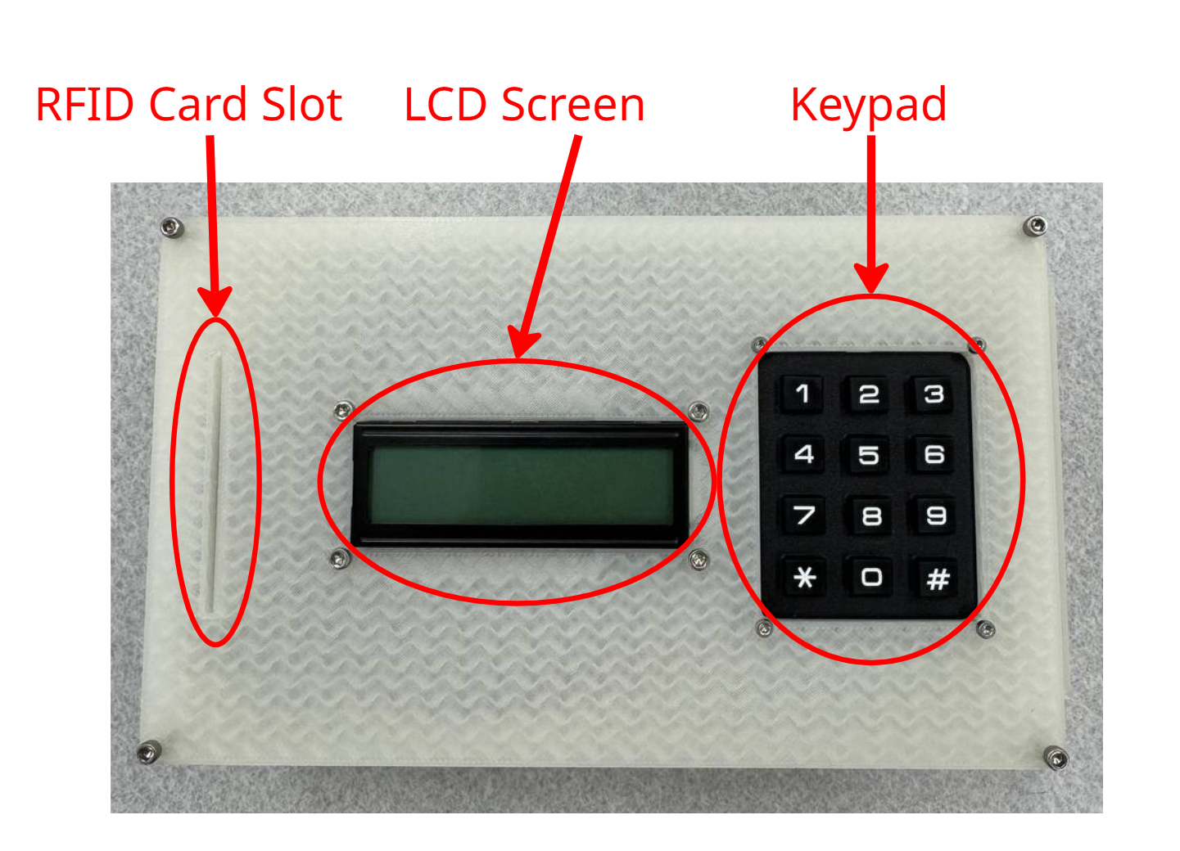
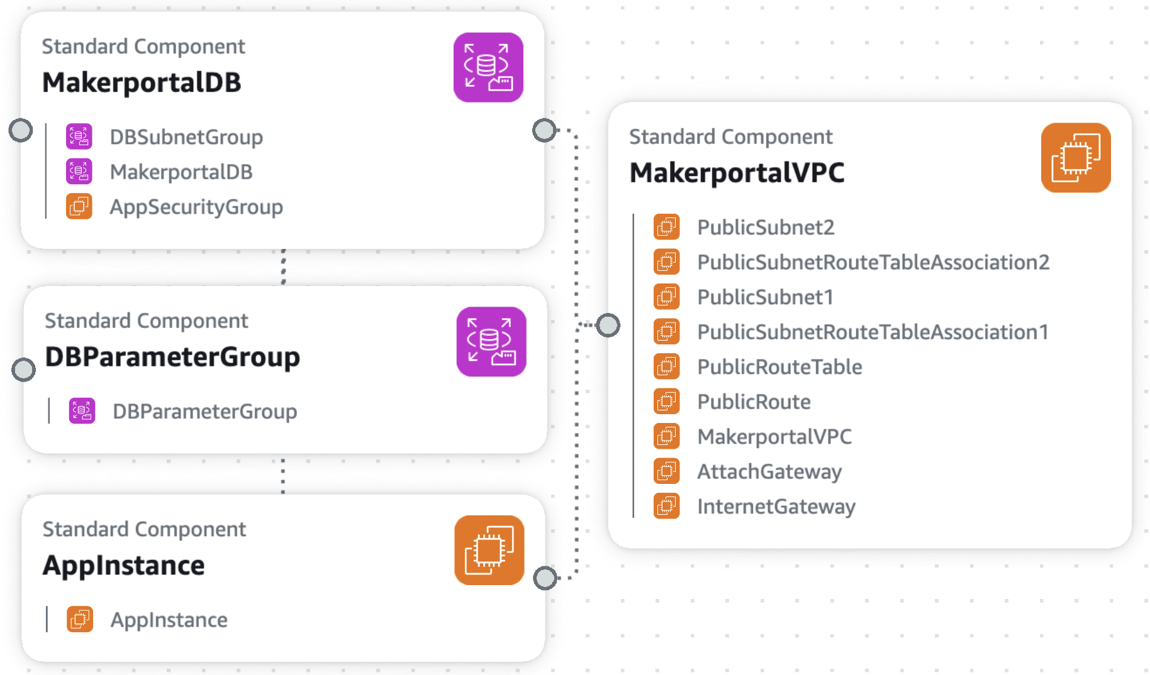
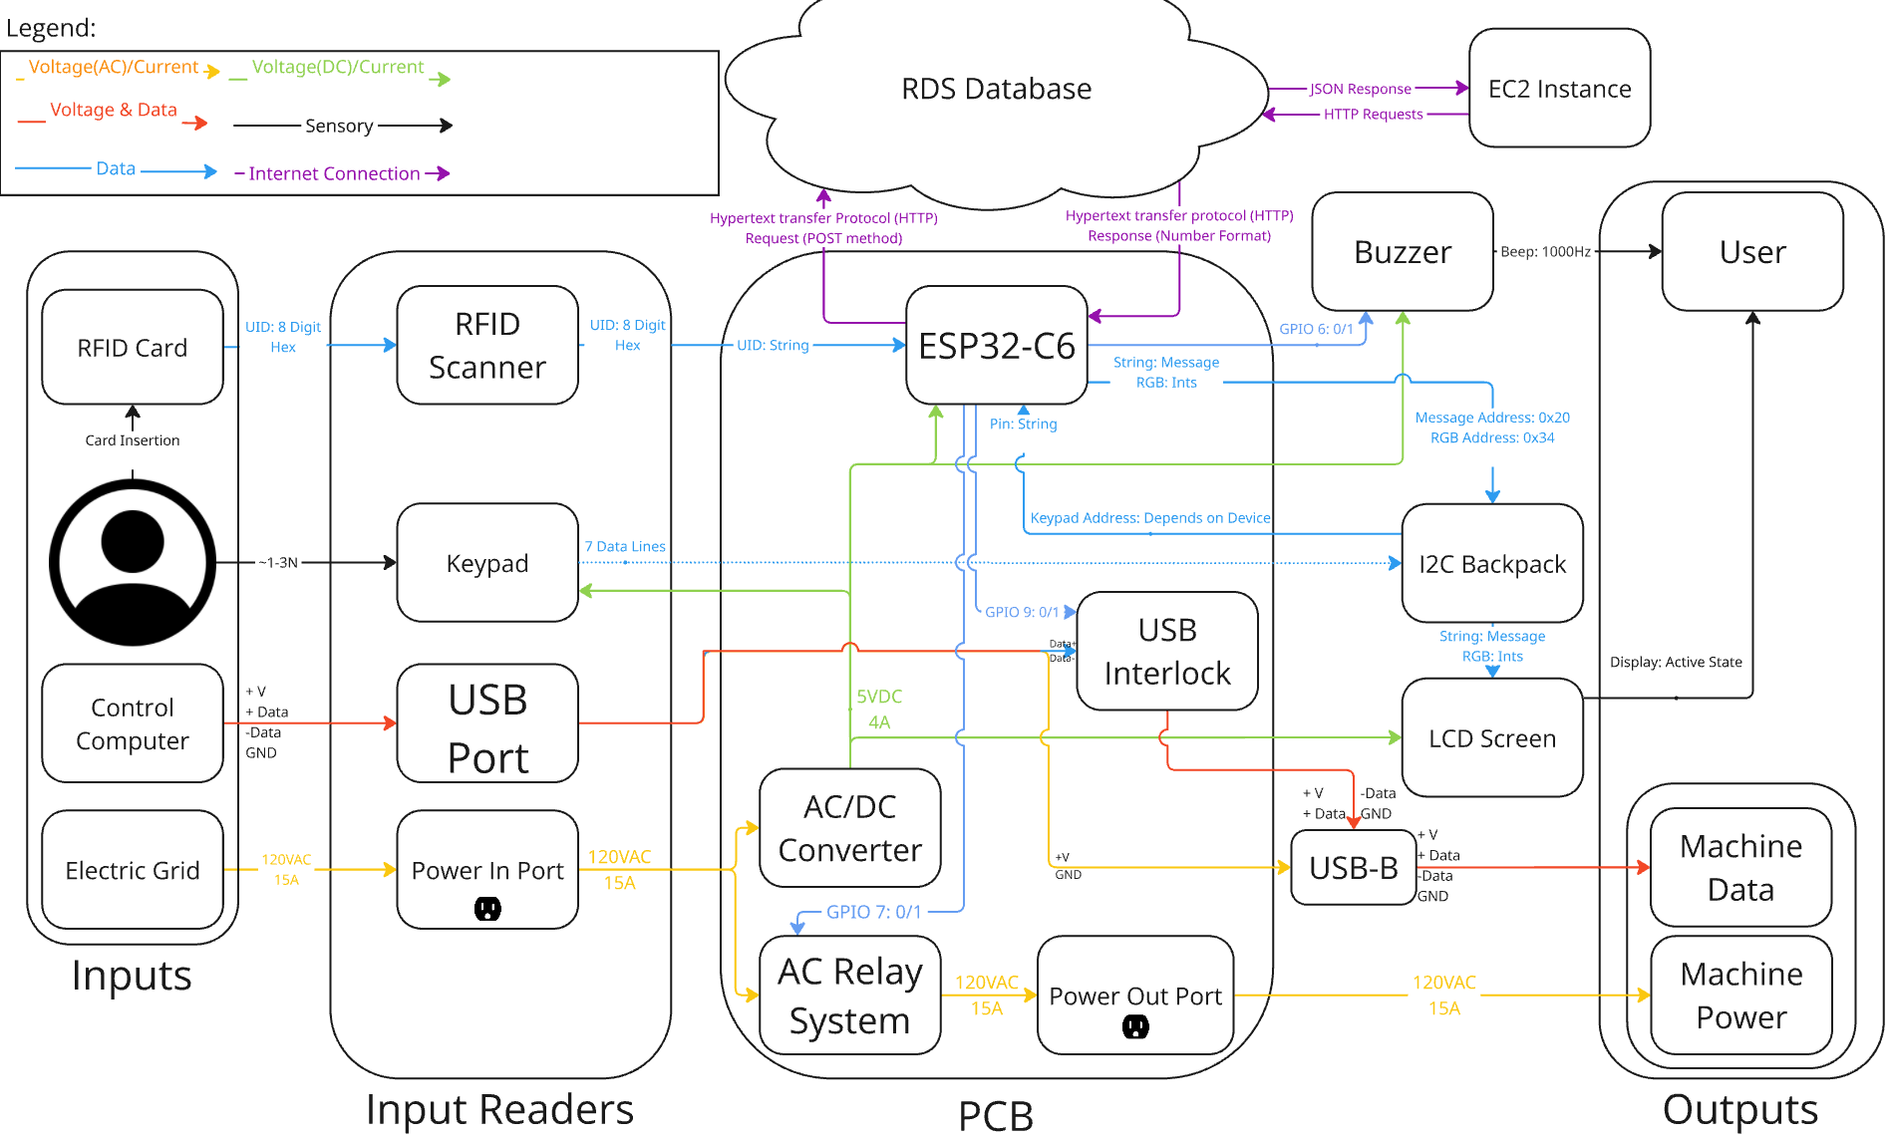
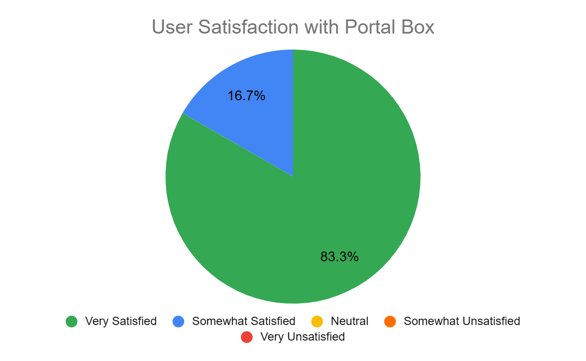
Portal Box V4
Axel Andrews, Peter Beaudette, Kevin Duong, Aidan Flynn, Colton Jiorle, James Powick
Electrical & Computer Engineering
Context & Value
Stakeholders & Impact
The Portal Box is an innovative project designed to address the issue of authorizing and training users for equipment in makerspaces. Many makerspaces around the world struggle with balancing security, safety, and accessibility in spaces with machinery that requires training for safe and proper operation. The Portal Box presents a middle ground solution that allows quick and easy access for authorized users, while also enabling the issuance and tracking of training for new users. Improving on past iterations (V1: 2016, V2: 2019, V3: 2021), the Portal Box V4 offers a more advanced, affordable, and flexible iteration that meets the evolving needs of makerspaces as they continue to proliferate around the world.
The project is open-source and designed to be built with common makerspace equipment (3D printer & soldering station), and our iteration simplifies the deployment process such that more makerspaces will adopt the devices. Our primary objective was rejuvenating Bucknell’s Portal Boxes (deployed in the MakerE, Mooney Lab, and ACET), but due to the promising value provided by the system, a large goal was to broaden expansion. Portal Boxes insert themselves at a critical juncture in makerspace operation, protecting users and expensive equipment alike. The V4 is deployed at STEAM Innovation Labs in Sunbury, and we hope to see it spread and benefit other institutions in the coming years.
Goals & Outcomes
Features & Functionality
Reduce Cost
Microcontroller Switch:
New iteration uses an ESP32-C6-DevKit ($9) with MicroPython, a switch from a Raspberry Pi 4 ($35) with CircuitPython.
V1, V2, V3: ~$140-220/Box depending on iteration.
V4: ~$75-103/Box depending on configuration.
Configurable Peripheral Setups (Figure 3):
Single Push Button: $75 per Box
LCD Screen + Button: $99 per Box
LCD Screen + Keypad: $103 per Box
Reduces average cost by ~49.8%
Optimization of Microcontroller
Decreased Boot Time: 91.7% reduction from 3 minutes to 15 seconds.
Efficient GPIO Usage: Old microcontroller was overbuilt and oversized.
Enhanced Security
Keypad: Enables 4 digit PINs which prevent sharing/theft of RFID cards.
Improved Ease of Use
LCD Screen: Provides informative prompts and updates to the user.
Admin Modes: Card Reader Mode & Authorization Mode decrease strain on makerspace technicians/directors by simplifying flows.
Proxy Card Holder: Keeps system organized.
Ease of Adoption
3D-Printed Enclosure: Simplifies build process in a widely replicable way
MakerPortal AWS CloudFormation: Template file allows for zero-code replication of website/database for new makerspaces using the system.
Detailed Assembly/User Guides: Full documentation package for replicating the system. ~2.5 hours to build entire system (minus 3D-print idle time)
Key Functionality (plug & play with existing system)
User Authentication:
Scans an RFID card to identify the user then connects to a database to verify their authorization status.
If authorized, machine access is enabled via a power relay. A USB interlock is also present and simultaneously enables access by enabling data to flow (ideal for machines that can’t be turned off).
New Features
Keypad and PIN: Increases security through two-factor authentication, enables bonus modes.
LCD Screen: Provides status updates, enables bonus modes, improves UX.
Upgraded RFID Card Slot: Increases security & UX.
Card-Reader Mode: Enables RFID card IDs to be displayed, simplifying admin’s role in adding new users.
Certification Mode: Enables user authorization without visiting MakerPortal.
Upgraded MakerPortal: Allows users to view/update their PIN. Zero-code AWS CloudFormation deployment allows setup in less than 15 minutes.
Upgraded Enclosure: Leverages 3D printing to simplify building process & cut costs. Allows for easy customization with 3 default versions of enclosure at 3 different price points (Figure 3 shows upper and lower end).
Figure 1. Portal Box in Idle State
Figure 1. Idle Portal Box State
Figure 2. Portal Box in Alternate States
Figure 2. Unauthorized Access Attempt
Initial User Feedback
Acknowledgements
After sampling users of the V4 Portal Box, it was clear that we achieved our goal of improved ease of use. All users were satisfied with their experience and felt that the LCD screen and LED lights provided enough information to them about what was happening. Along with that, users understood that entering a PIN was good for security but felt cumbersome. Overall, the V4 was easy to use, informative and had a satisfying user experience. Our project was accepted by our client on 4/24/25.
Our project was supported by many people inside and outside of Bucknell. We are extremely grateful to everyone who made an impact and assisted us along the way. We don’t have room to thank everyone, but those listed below played a special role in our development:
Matt Lamparter: Bucknell Director of ECE Labs - Our Client & Main Supporter
Tom Egan: Lewisburg-based Software Developer - Long-time Portal Box Developer
STEAM Innovation Labs: Makerspace in Sunbury - Hosted First External Portal Box Deployment
Profs. Alan Cheville & Amal Kabalan: ECE Senior Design Professors - Guided the Team Throughout the Year
2016/2019 Senior Design Teams: Bucknell Alumni - Created Past Iterations of Portal Boxes
Interviewees: Guided Development of New Iteration
Figure 3. Block Diagram

